Slide 1




SMART INDIA HACKATHON 2026
AGROVON 3.0
• Problem Statement ID – SIH26180
• Problem Statement Title - A field-deployable AI-powered Smart Farming Assistant
• Theme-Disaster Management
• PS Category- Hardware
• Team ID-GLAH8
• Team Name - Code Verse

Slide 2
Idea Title
CODEVERSE
AgroVON - Offline Edge AI & ESP-NOW Smart Farming Intranet
IDEA / SOLUTION
Bypasses Poor Connectivity: Processes heavy video locally on the edge, requiring zero cloud internet.
Proactive Management: Merges soil sensors and AI vision to detect threats before yield loss.
Unified Interface: Consolidates all hardware and AI diagnostics into a single dashboard.
Problem Resolution
Unique Value Proposition
Zero-Cloud Architecture: Eliminates expensive cloud computing costs and ensures complete farm data privacy.
Ultra-Low-Cost Scalability: Uses economical $5 ESP32-CAMs for the field, centralizing all heavy processing on a single Pi.
Fault-Tolerant Design: The asynchronous Python backend instantly handles hardware or camera disconnects gracefully without crashing the system.
Edge-AI IoT Ecosystem: A decentralized smart farming system bridging ESP32 hardware sensors with a Raspberry Pi 5 edge hub.
Local AI Inference: Runs a custom YOLOv8 model entirely on-device for real-time plant disease detection and soil monitoring via a React Native app.
@SIH Idea submission-
2

Slide 3
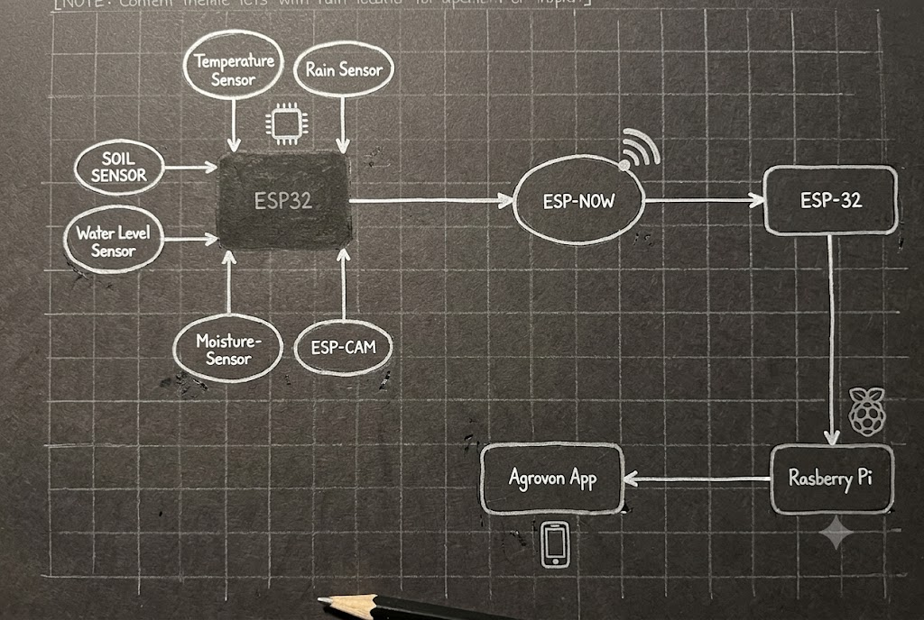
CODEVERSE
TECHNICAL APPROACH
1. Hardware & Edge Infrastructure
Raspberry Pi 5: Central Edge-AI Server (Runs models offline).
ESP32 & ESP32-CAM: Low-power microcontrollers for distributed sensor and vision nodes.
ESP-NOW: Long-range wireless communication without internet.
5V Relay: Actuator module for automated pump control.
2. Disaster & Environment Sensors
Soil Moisture & DS18B20: Detects drought conditions and monitors soil temperature.
DHT22: Tracks ambient heat stress and humidity levels.
Rain & Water-level Sensors: Provides early warnings for floods and waterlogging.
3. AI & Software Ecosystem
TensorFlow Lite & MobileNetV2: Lightweight, high-accuracy model for classifying 38 crop diseases locally.
Python / Flask: Backend logic and local API server running on the Pi.
React Native: Cross-platform mobile dashboard for real-time farmer alerts.
C++: Firmware programming for ESP32 data acquisition and telemetry.
@SIH Idea submission
3

Slide 4
CODEVERSE
FEASIBILITY AND VIABILITY
Technical (100% Offline Edge): Bypasses rural internet dependency. Uses ESP-NOW for local mesh telemetry and Raspberry Pi 5 for on-site TFLite AI inference.
Economic (Zero Recurring Cost): Highly affordable one-time investment. Built with off-the-shelf ESP32s and completely eliminates AWS/GCP server fees.
Operational (Zero-Touch Automation): Requires zero technical expertise from farmers. Instantly mitigates disaster via relay-triggered pumps and pushes simple, color-coded alerts to a local React Native dashboard.
@SIH Idea submission
4

Slide 5
IMPACT AND BENEFITS
CODEVERSE
Combating ₹1.4 Lakh Crore Crop Losses: India loses over ₹1.4 lakh crores of crops annually to diseases, floods, and extreme weather. AgroVON's early-warning system directly mitigates this massive economic disaster.
Optimizing National Water Usage: Agriculture consumes nearly 80% of India's freshwater. By delivering precise, real-time soil moisture alerts, AgroVON prevents over-watering and waterlogging, directly addressing the national water crisis.
Maximized Crop Yield: Edge-AI disease classification stops fungal and pest outbreaks at the individual plant level before field-wide contamination.
Financial Independence for Farmers: Protects rural livelihoods and reduces the risk of farmer debt by ensuring consistent harvests with absolutely zero recurring cloud or software costs.
@SIH Idea submission
5

Slide 6
CODEVERSE
RESEARCH AND REFERENCES
Agricultural Economic Impact: Data on the ₹1.4 Lakh Crore annual crop loss due to extreme weather, floods, and diseases referenced from Indian Council of Agricultural Research (ICAR) and Ministry of Agriculture reports.
Water Conservation Data: Statistics confirming agriculture consumes ~80% of India's freshwater sourced from NITI Aayog and World Bank water management reports.
AI Training & Dataset: The 38-class Edge-AI disease classification model was trained and validated using the globally recognized PlantVillage Dataset.
Edge Computing & Telemetry: Network and inference architecture based on official TensorFlow Lite (Edge AI deployment) and Espressif (ESP-NOW ) documentation.
Core Problem Statement: SIH26180 – "Field-deployable AI-powered Smart Farming Assistant" curated by Qualcomm Inc. & BlinkNBuild.
@SIH Idea submission
6

